Slide 1

Pl / SQL
2024
FDTMS
Fraud Detection & Transaction Monitoring System
Real-Time High-Value Withdrawal Detection and Automated Processing Halt Using Oracle PL/ SQL
Byiringiro Octave : 27493

Slide 2

Problem & Context.
2024
Commercial banks in East Africa and worldwide lose hundreds of millions annually due to unauthorized high-value withdrawals executed during automated nightly batch processing. Current core banking systems process thousands of transactions blindly without real-time risk checks. A single withdrawal of $50,000 or more, if fraudulent or mistaken, can cause irreversible financial and reputational damage before human review occurs the next day.

Slide 3

Solution, Objectives & Scope
Build a production-ready Oracle solution using PL/SQL packages to enforce the $50,000$ threshold.
Real-Time Circuit Breaker with Atomic Rollback:
Critical Compliance Restriction via Database Trigger
Comprehensive, Autonomous Audit Trail

Slide 4

2024
Database Architecture
Key Entities:
BANK_TRANSACTIONS, ACCOUNTS,FDTMS_BATCH_CONTROL, and FDTMS_AUDIT_LOG. Normalization: All tables are normalized to 3NF.

Slide 5
Business Process Model
1. Submit Batch of Transactions
2024
Transfers data to the database.
2. Execute process_batch_transactions
The PL/SQL Package (FDTMS_PKG) takes control.
3. CRITICAL DECISION POINT
Checks if trans_type = 'WITHDRAWAL' AND amount >= \$50,000 (c_fraud_threshold).
4. HALT & ROLLBACK
If YES, the system executes the GOTO statement to force a ROLLBACK, logs the alert, and updates the batch status to HALTED.
Illustration of the workflow of transaction processing, emphasizing the point where the PL/SQL system intervenes to enforce the circuit breaker logic.
5. Manual Review Queue
If status is HALTED, the transaction waits for human review (decision to clear or permanently reject).
6. Commit or Clear
If the initial decision was NO, or if the review clears the batch, the remaining transactions are updated to CLEARED and committed.

Slide 6

Technical Foundation The PL/SQL Core Logic
Oracle Database (PDB) and PL/SQL.
Key Technical Achievements
Centralized Logic:
All core fraud detection, logging, and status control are encapsulated in the FDTMS_PKG package.
Atomic Rollback:
The procedure uses a GOTO statement to bypass normal processing and trigger a database rollback. This ensures that if the $\text{\$50,000}$ threshold is met, the high-risk transaction and any previously processed transactions in that batch are never committed.
Autonomous Logging:
Critical status updates and fraud alerts use PRAGMA AUTONOMOUS_TRANSACTION to guarantee that the alert is recorded in the FDTMS_AUDIT_LOG and the batch status is updated, even if the main transaction is rolled back.

Slide 7
Compliance and Auditing
2024
Implementation of triggers for security and auditing.
Non-Negotiable Security: DML operations on core transaction data are disabled on Weekdays and Public Holidays via the TRG_BANK_TRANSACTIONS_RESTRICT trigger.
Irrefutable Compliance: All DML attempts are logged in the FDTMS_AUDIT_LOG using an Autonomous Transaction, guaranteeing an audit trail even if the DML fails or the main session rolls back.
Advanced Trigger Use: Employed the Compound Trigger structure for efficient capture of the user and the specific DML action type (INSERT, UPDATE, DELETE) for auditing.

Slide 8
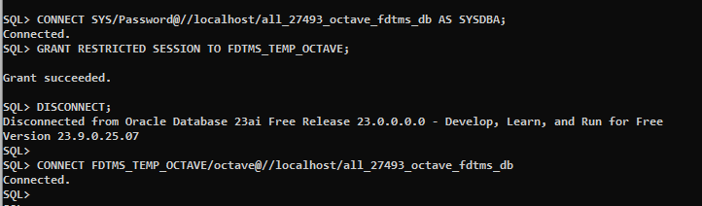
2024
Technical Results & System Validation Proof
Key Validation Proofs
creating users and giving granting p[ermissions to users

Slide 9
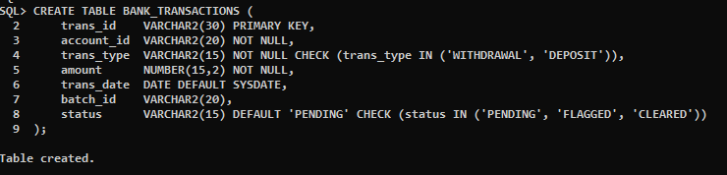
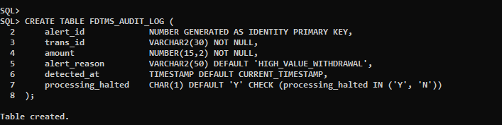
pl / sql
Technical Results & System Validation Proof
2024
Key Validation Proofs
creating the tables “bank transaction”
creating the tables “audit log”

Slide 10
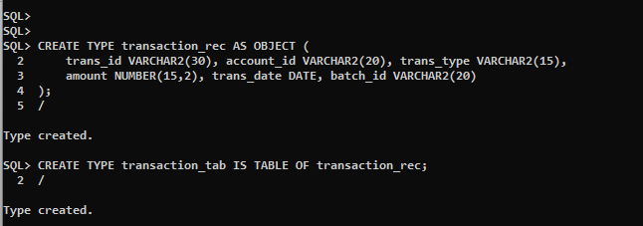
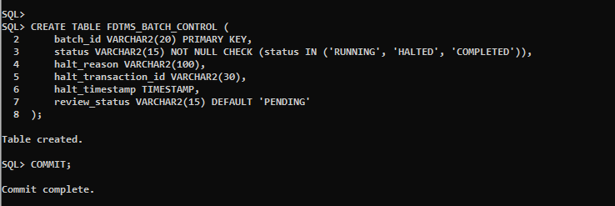
pl / sql pany name
Technical Results & System Validation Proof
2024
Key Validation Proofs
creating the tables “transaction_rec, and batch control”

Slide 11
Conclusion, Future Scope, & Q&A
2024
Successful implementation of a complete, end-to-end fraud management system entirely within the Oracle Database ecosystem.
Project Conclusion
Requirement Fulfillment: Successfully implemented all technical phases (I-VIII), delivering a complete, integrated FDTMS solution.
System Proactiveness: Transformed passive data into a proactive, rule-based fraud detection engine using native Oracle PL/SQL.
Core Success: Validated the system's ability to automatically HALT high-risk transactions and provide real-time operational insights via Power BI.
Future Scope & Enhancements
Dynamic Rule Engine: Externalize all fraud thresholds ( $5,000 limit) into a configuration table to allow business users to update rules without code modification.
ML Integration: Implement analytical models to detect evolving, non-static fraud patterns not covered by current static rules.
Automated Workflow: Integrate external applications to manage the manual review queue, enabling analysts to release cleared batches directly.
Thank you for your attention.

